Slide 1
Govtech Section 3
Design 1

Slide 2
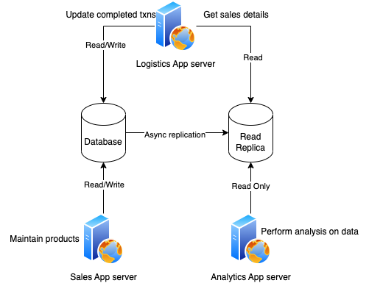
Design 1
The database has a disaster recovery in terms of a read replica. The read replica can be useful as it can serve Analytics purposes as a read-only database.
Logistics application will generate reports from the read replica while update completed transactions on the main database.
Sales application will connect to the main database as they need both read and write capabilities in order to maintain their products catalog.

Slide 3
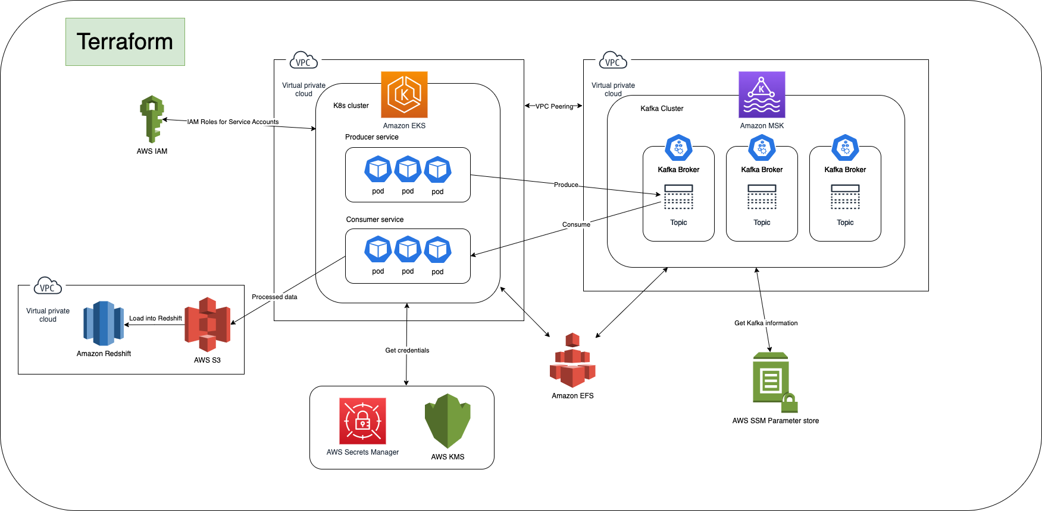
Design 2

Slide 4
K8s Cluster
Hosted on Amazon EKS.
Producer service (Images uploaded by users). This service will push the image data into a kafka topic (see next slide).
Consumer service (Process uploaded images). This service process the uploaded image and uploads the data into Amazon S3 for storage.
Self-managed nodes is preferred because we need precise scaling. We want to avoid Kafka rebalancing frequently due to consumers getting added or dropped automatically when EKS scales.
Use Amazon EFS to mount encrypted file system to pods in EKS. This will make data stored on the file system to be encrypted.
Data in transit can be encrypted with TLS 1.2.

Slide 5
Kafka Cluster
Hosted on Amazon MSK. Selected due to ease of maintenance.
Retrieve kafka broker and zookeeper connection details with AWS SSM Parameter store.
Monitor resource usage with CloudWatch.
VPC peering with Amazon EKS to enable traffic.
Specify the AWS KMS key for MSK to use to encrypt data at rest.
MSK uses TLS 1.2 to encrypt data in transit.

Slide 6
Redshift
Chosen as the data warehouse of choice.
Consumer service uploads processed image data onto S3. The data in S3 is then loaded into Redshift.
Data scientists and analysts can use Redshift for their data needs.

Slide 7
IAM
Perfect for controlling resource access.
Manage IAM roles for both service accounts and employee AWS accounts.

Slide 8
Terraform
MSK is now integrated with Terraform, allowing description and provisioning of Amazon MSK clusters with code.
Terraform can also deploy Amazon EKS clusters. It provides simply full cycle management for ease of resource management.

